Slide 1
Welcome!

Slide 2
Chen Hsong – Who Are We?
One of the largest producers of injection moulding machines in the world
Annual production exceeds 15,000 machines

Slide 3
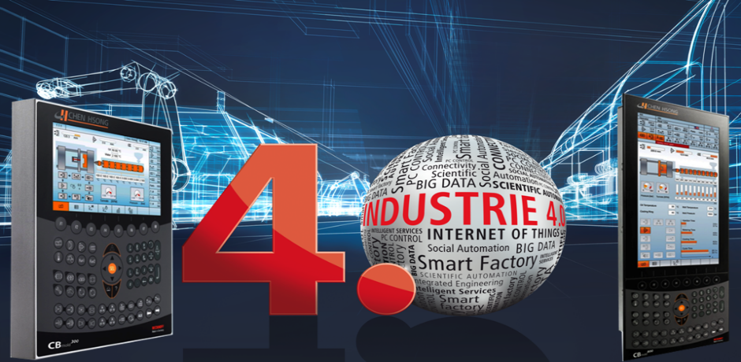
Industrie 4.0 And The Modern Work-Flow

Slide 4
What is Industrie 4.0?
Define

Slide 5
The Four Stages of Industrial Revolution

Slide 6
What is Industrie 4.0?
Originated in Germany in the 2000’s
Termed “Cyber-Physical Systems” (CPS) in the USA
Driven by needs of an aging population and rigorous demands of modern life-styles
It is a research goal – there is no Industrie 4.0 factory yet

Slide 7
Defining Characteristics of Industrie 4.0
Interoperability
Virtualization
Decentralization
Real-Time
Service Orientation
Modularity
Source: Design Principles for Industrie 4.0 Scenarios, 2015, Hermann et al

Slide 9
Industrie 4.0 – Simplified View
Communi-
cations
Branches
Trunk
AI
Root
BIG DATA

Slide 10
The Goals of Industrie 4.0
Cyber-Physical Systems = Bridge Cyber (Computers) and Physical (Machines)
Let the Machine Think (so you don’t have to)
compare with 3.0 – Let the Machine Work
Mass Customization = Mass Personalization
the coming of penultimate individualism
3D printing technology likely to accelerate trend
Individualized Service a Possibility (or the norm)

Slide 11
What does it mean, really?
At Hannover Messe 2016, then President Obama of the USA visited the Siemens booth, asking the same question
Siemens CEO Joe Kaeser gave him a golf club which was custom-designed and custom-manufactured to perfectly fit Obama’s size and swing style
Such a personalized golf club cost no more to make than a regular, mass-produced model

Slide 12
BIG DATA The Basis of Everything
#1

Slide 13
First You Must be Able to Collect All That Data…
Entering the era of
BIG DATA
Basic
Advanced
Enterprise
Ultimate
1GB flash storage
8GB flash storage
16GB flash storage
32GB flash storage
is your equipment BIG DATA-ready?

Slide 14
Then What Can You Do With It?
EXAMPLE:
Stores the injection speed and pressure curves of EVERY cycle within the past month.

Slide 15
Store All That Data into The Cloud
Injection moulding
machine
Chen Hsong
Cloud Database
Injection curve for each cycle
But Then What?

Slide 16
Cloud-Based Data Management
access data on cloud
4G
Chen Hsong Cloud
data
Data
Injection moulding
machine
Scans
QR
code
Moulding part
Customer
QR code printer
Sticker

Slide 17
What’s Good About This?
Easy
Secured
Zero Maintenance
Zero Labour
No Fuss

Slide 18
iChen™ 4.0 Cloud Intelligence
Trends &
Intelligence
Alerts &
Alarm
Triggers
Chen Hsong
Cloud Database
Big Data Map-Reduce (MR) processing and Machine Learning (ML) on trends prediction and pattern recognition
Advanced
Analytics

Slide 19
Service Implications
How can BIG DATA help improve service levels?

Slide 20
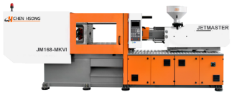
Chen Hsong Cloud Preventive Maintenance
Coming
Soon!
3G/4G
Chen Hsong technicians show up before problem occurs
Injection moulding machine
Cloud-based, with BIG DATA calculations, continuously monitors sub-systems performance
Monitors parts wear and tear
Discovers potential failures before they happen

Slide 21
Work Flow Implications
How can BIG DATA help stream-line work flows

Slide 22
EXAMPLE:
Time Machine
Restore machine to the exact state of any time within the past month

Slide 23
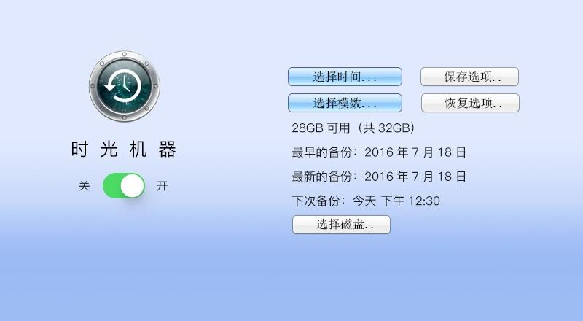
Time Machine – In Action

Slide 24
AI Making Sense Out of All Those DATA (so you don’t have to)
#2

Slide 25
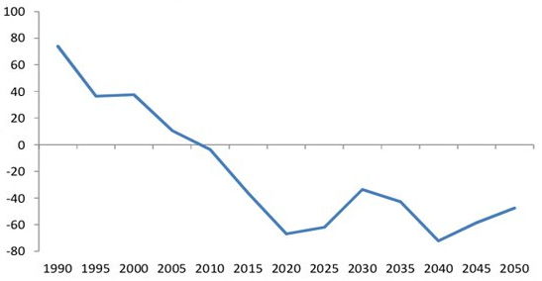
China’s Big Problem: Fewer and Fewer Workers
Manual Labour Supply (China)
millions
* Population aged 15-19 minus 50-54 and new university students
Source: CEIC, UN, CS

Slide 26
Artificial Intelligence to the Rescue
AI Auto-Tune
Through machine learning processes, the controller automatically sets and fine tunes moulding parameters without human interference. Now That’s smart.
* Click-Once *

Slide 27
Traditional Machine Controller Setup Screen

Slide 28
Mistakes are Just Too Easy…
Oops!

Slide 29
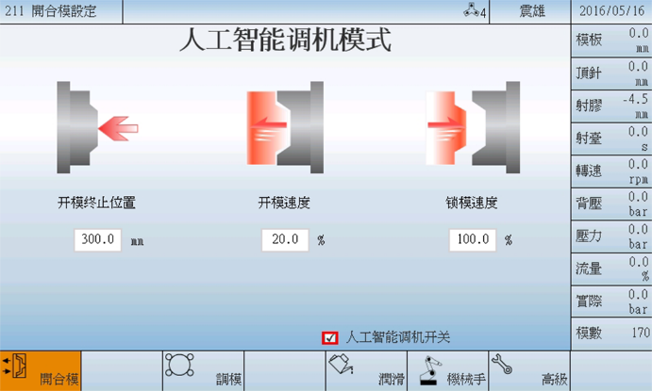
AI Auto Setup – No Trained Technicians Needed

Slide 30
How AI Alleviates Labour Shortages?
Knowledge-base
Auto check-up’s and diagnostics
Auto monitoring
Worldwide data mining of stored data
Patterns recognition and proactive actions
Reminders and alerts
Leaving humans to what they are best at: Solve Problems and Make Decisions

Slide 31
Communications The Way We Talk to Machines or How They Talk to US
#3

Slide 32
Common Myth: Industrie 4.0 is Complicated
MYTH BUSTER
NO.
If it is complicated, it is not Industrie 4.0.

Slide 33
What Do Humans Use to Communicate?
WhatsApp
WeChat
Facebook Messenger
iMessage
LINE
Skype
Email
SMS
Good Old Phone Call

Slide 34
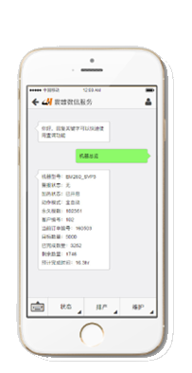
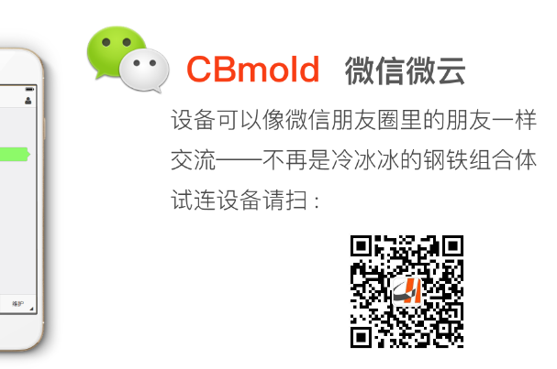
Machines Learning to Talk to US
+ WeChat ®
Equipment = Friend
Management = Chat Group

Slide 35
Conclusion Remember This Tree
BIG DATA
Data underlies EVERYTHING
AI
Think for us
Communications
Talk to us

Slide 36
Thank You!

