Slide 1
MK6 vs XX-II/IIS (Internal Confidential)

Slide 2
Measured Performance
Specifications vs Actual Measured
INTERNAL ONLY

Slide 3
Summary Scoring
Model | General | Electricals | Hydraulics | Mechanics | Total Score
JM168-MK6 |  |  |  |  | 16
XX1600II |  |  |  |  | 12
XX1600IIS |  |  |  |  | 12

Slide 4
Highest Actual Measured Speed for All Specifications at 99% Settings
 |  | Units | XX1600II | XX1600IIS | JM168-MK6
Max. Clamp Closing Speed |  | mm/s | 696 | 638 | 817 (+28%)
Max. Clamp Opening Speed |  | mm/s | 1,197 | 1,010 | 1,313 (+30%)
Max. Injection Speed |  | mm/s | 104 | 100 | 108 (+8%)
Max. Plasticizing Speed |  | rpm | 206 | 217 | 224 (+9%)
Ejector | Max. Eject Speed | mm/s | 375 | 295 | 527 (+79%)
 | Max. Return Speed | mm/s | 355 | 341 | 496 (+45%)
Carri-age | Max. Fwd Speed | mm/s | 50 |  | 102 (2x)
 | Max. Bwd Speed | mm/s | 62 |  | 77 (+24%)
Max. Mould Adj. Speed |  | mm/s | 2.0 | 2.3 | 2.5 (+25%)

Slide 5
Comparison in Actual Production
 | XX1600II | JM168-MK6
Part | Thin-Walled Enclosure Part
Resin | ABS
Screw Diameter | D45 | D46
Shot Weight | 28.1g | 28.1g
Cycle Time | 29.1 sec. | 21.2 sec. (-27%)
Productivity | 120 / hour | 169 / hour (+41%)
Electricity Consumption | 796 kW/kg | 634 kW/kg (-19%)

Slide 6
What Makes The Difference
Precision Hydraulics®
for the MK6

Slide 7
Precision Hydraulics®
Precision at HIGH SPEED
(JM168-MK6 has sustainable dry cycle of only 1.9s)
Next-Gen computer control algorithms and hydraulics circuit design
Developed by senior Japanese engineers with decades of technical expertise, using advanced hydraulics simulation software
Enhancement of 3rd Gen Servo-Pump technology: from 3G to 4G
Eliminates unnecessary pressure drops for ultimate precision
Rock-Solid Stability
(little vibrations and shocks even running at max. speed)
High Repeatability
(tolerances < 0.05%)

Slide 8
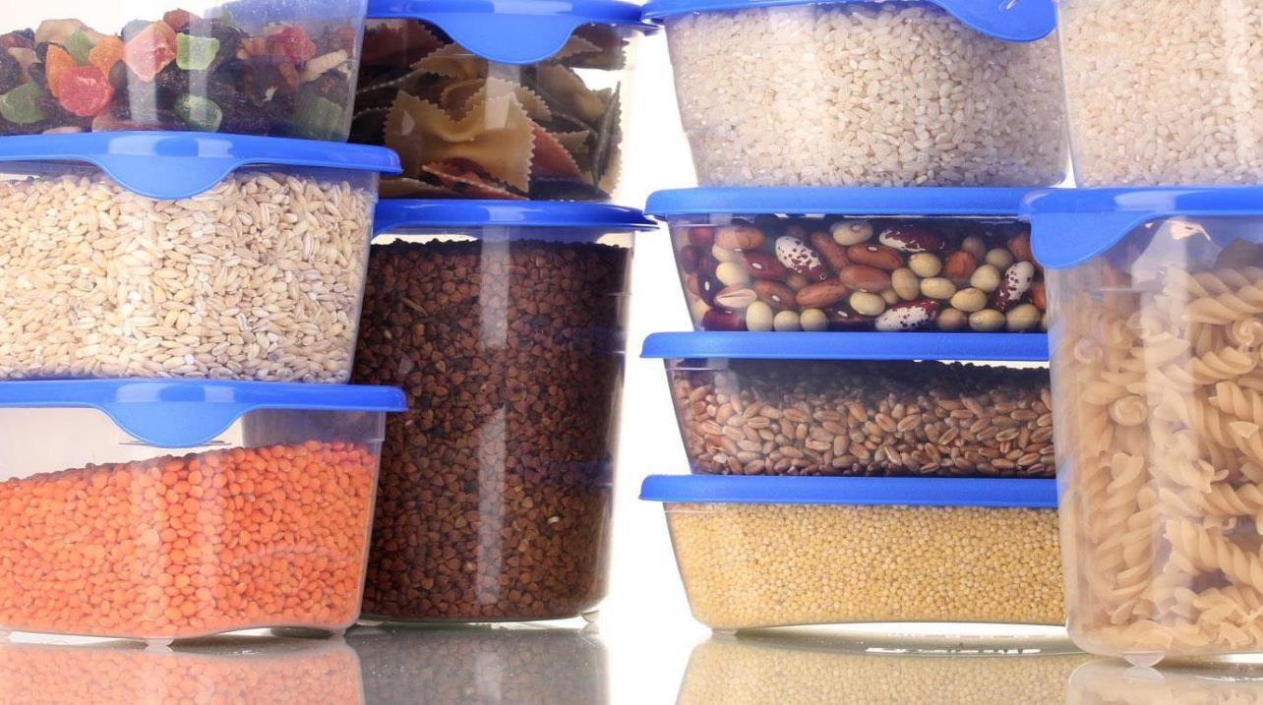
Injection Performance
Comparisons of Injection Specs &
Actual Measurements
INTERNAL ONLY

Slide 9
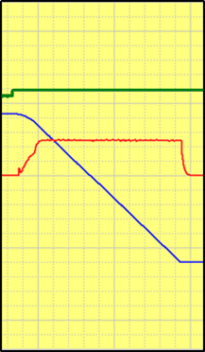
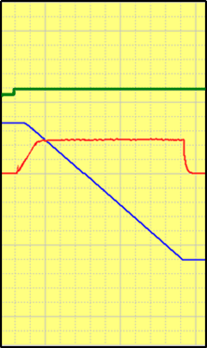
Injection Speed Response (0 → 99%)
300ms
320ms
220ms
Injection speed response curves from 0-99%
Smaller numbers are better
Look for: smoothness, no fluctuations, no overshoots
Command
XX1600II
XX1600IIS
JM168-MK6
Actual Speed
Position

Slide 10
The Importance of Speedy Response
JM168-MK6
XX1600II
Notes
Response is similar to a sports car – 0-100kph acceleration time
Smooth rides at high speed demands quick responses
Snappy responses reduce cycle times, increase productivity
Quick responses are particularly beneficial to difficult or thin-walled moulding processes
XX1600IIS
Speed
(0 → 99%)
220ms
300ms
Time
320ms

Slide 11
Injection Pressure Control
Look for: smoothness, no fluctuations, no overshoots
Injection pressure control is vital to ultimate part quality
Special materials (e.g. engineering resins) are particularly sensitive to pressure fluctuations
Stable injection pressure has a definitive impact on yield rates
MK6 has superior pressure control
XX1600II
XX1600IIS
JM168-MK6

Slide 12
Injection Base Pressure and Pressure Drop
Pressure Drop (bar)
Smaller numbers are better
Base pressure and pressure drops are non-work wasted energy dispersed as heat, requiring even more energy to cool
High base pressure or pressure drops leads to significantly lower power efficiency and energy saving
MK6’s Precision Hydraulics® all but eliminates pressure drops and has very low base pressure
8
Lose
35%
4
Lose
21%
15
15
10
Base
Pressure
(bar)
Base
Pressure
(bar)
XX1600II
XX1600IIS
JM168-MK6

Slide 13
Injection Pressure: Spec. vs Actual Measured
Mismatch between spec. and actual
(MPa)
Spec.: 188
Actual: 192
Injection pressure: bigger numbers are better
Higher injection pressure means better and more consistent part quality
Should not exist material differences between actual measured pressure vs specification
188
Spec.: 178
diff
15%
Spec.: 169
23
diff
15%
22
155
147
Actual
Measured
(MPa)
XX1600II
XX1600IIS
JM168-MK6

Slide 14
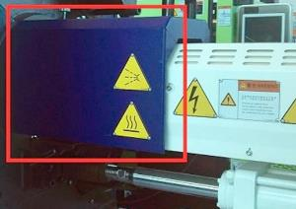
Nozzle Protection Guard
Window
no window
Window
XX1600II
XX1600IIS
JM168-MK6
Easy to operate
not convenient
Easy to operate

Slide 15
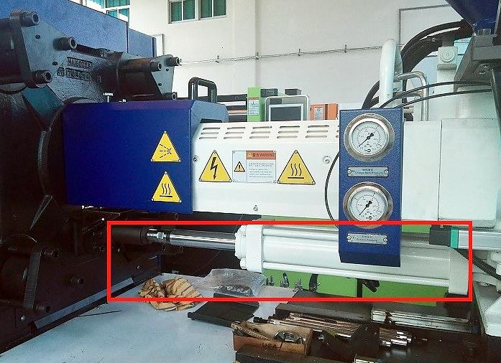
Injection Carriage Cylinders
Single Cylinder
Single Cylinder
Dual Balanced
XX1600II
XX1600IIS
JM168-MK6
Forces unbalanced
Hinders high-speed
injection
Forces unbalanced
Hinders high-speed
injection
Completely balanced
for high speed

Slide 16
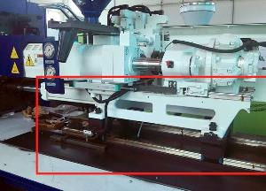
Injection Base
traditional guide rods
Linear Rails
Linear Rails
XX1600II
XX1600IIS
JM168-MK6
not designed for
high-speed injection
Smoothness for
high-speed injection
Smoothness for
high-speed injection

Slide 17
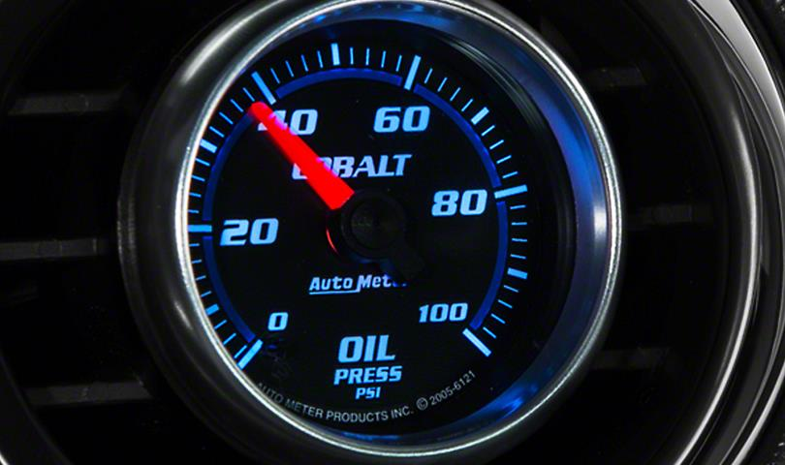
Holding Performance
Comparisons of Holding Specs &
Actual Measurements
INTERNAL ONLY

Slide 18
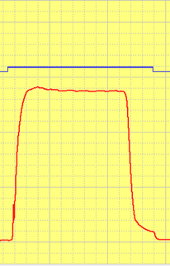
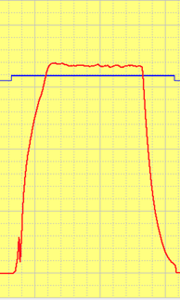
Holding Pressure Response (0 → 99%)
290ms
590ms
270ms
Holding pressure response curves from 0-99%
Smaller numbers are better
Look for: smoothness, no fluctuations, no overshoots
Stable holding pressure is vital to part quality and high yield
XX-IIS degrades response speed to avoid overshoots from higher system pressure
XX1600II
XX1600IIS
JM168-MK6
Pres.
Cmd.

Slide 19
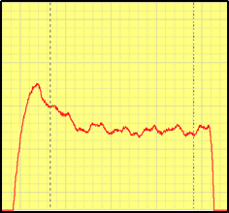
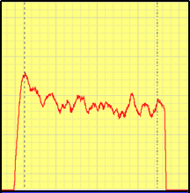
Pressure Control
Look for: smoothness, no fluctuations, no overshoots
XX-II/IIS have lower quality pressure control – i.e. high fluctuations and overshoots
MK6’s innovative Precision Hydraulics® technology yields precise pressure control
Precise pressure control is vital for demanding, pressure-sensitive applications such as optical parts
XX1600II
XX1600IIS
JM168-MK6

Slide 20
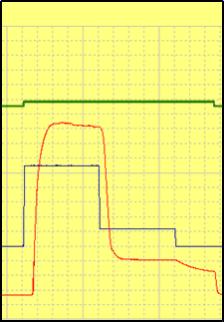
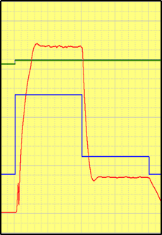
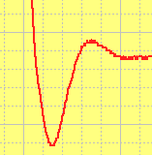
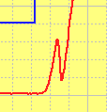
V/P Switch-Over Response
Patented
Technology
Look for: smoothness, no fluctuations, no overshoots
Precise and stable V/P switch-over is vital for demanding applications requiring precise dosing
Injection Command
XX1600II
XX1600IIS
JM168-MK6
Actual Pressure
Pressure Command

Slide 21
Plasticizing Performance
Comparisions of Specs &
Actual Measurements
INTERNAL ONLY

Slide 22
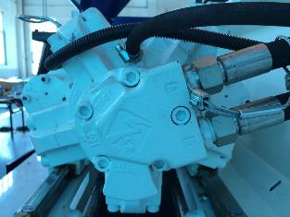
Plasticizing Motor Size and Torque
slow and weak
even slower and weaker!
Fast and Strong
XX1600II
XX1600IIS
JM168-MK6
Size: 500cc
Unit torque: 66 Nm
Size: 400cc
Unit torque: 51 Nm
Size: 500cc
Unit torque: 80 Nm

Slide 23
Plasticizing Torque
Model | Screw Diam. | Flow Rate | Unit Torque | Max. Pressure | Max. Torque
JM168-MK6 | 46mm | 500cc | 8 | 175 bar | 1,400
XX1600II | 45mm | 500cc | 6.6 | 140 bar | 924
XX1600IIS | 45mm | 400cc | 5.1 | 175 bar | 714
34%
49%
Due to reduced power-pack of the XX-IIS, the hydraulic motor is artificially made smaller to maintain plasticizing speed, at the expense of very low torque (bad for engineering resins)

Slide 24
Plasticizing Back Pressure Control
Tracking closer to optimal (blue line) better
Precise back pressure control is vital for processing sensitive resins
MK6 almost tracks optimal perfectly, even at low pressure
XX-II/IIS consistently overshoots and cannot achieve low back pressure

Slide 25
Max. Heater Power
12.9
kW
29%
11.8
kW
Bigger numbers are better
Inadequate heating power reduces plasticizing quality and efficiency, lengthens cycle time
10
kW
XX1600II
XX1600IIS
JM168-MK6

Slide 26
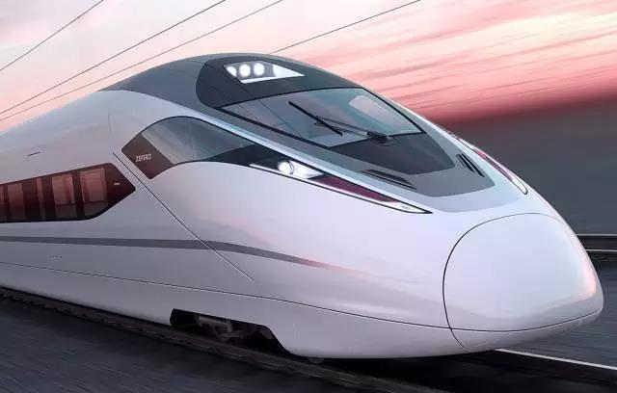
Clamp Performance
Comparisons of Platen and
Toggle Designs, Specs &
Actual Measurements
INTERNAL ONLY

Slide 27
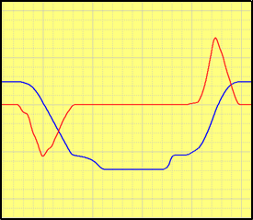
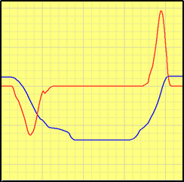
Dry Cycle Time
3.4 sec. (+80%)
Japanese Hydraulic
& Mechanical Tech.
Smaller numbers are better
Look for: smooth motion, no fluctuations, no overshoots
MK6’s toggle mechanism and hydraulic circuit is based on advanced Japanese designs, enabling ultra-high speed operations
XX1600IIS
1.9 sec.
3.5 sec. (+84%)
XX1600II
JM168-MK6
Clamp Speed
Clamp Position

Slide 28
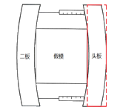
Platen Deformation
Smaller numbers are better
Large deformations can cause flashes
MK6 v.next will target <0.1mm deformation
0.166mm
0.148mm
0.15mm
XX1600II
XX1600IIS
JM168-MK6

Slide 29
Uniformness of Tie-Bar Deformations
Japanese
Toggle Design
All four tie-bars must deform equally, or uniformly, for the best part quality without flashes and internal stresses
Only MK6’s special toggle design based on advanced Japanese technology guarantees absolute uniformity
XX1600II
XX1600IIS
JM168-MK6
> 10%
1-10%
< 1%

Slide 30
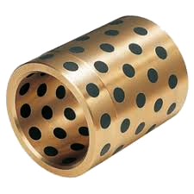
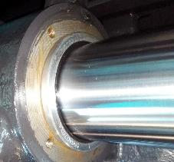
Bushings for the Moving Platen
Oil-less
Bushings
metallic
metallic
XX1600II
XX1600IIS
JM168-MK6
high friction
high friction
Smooth motion
Low friction

Slide 31
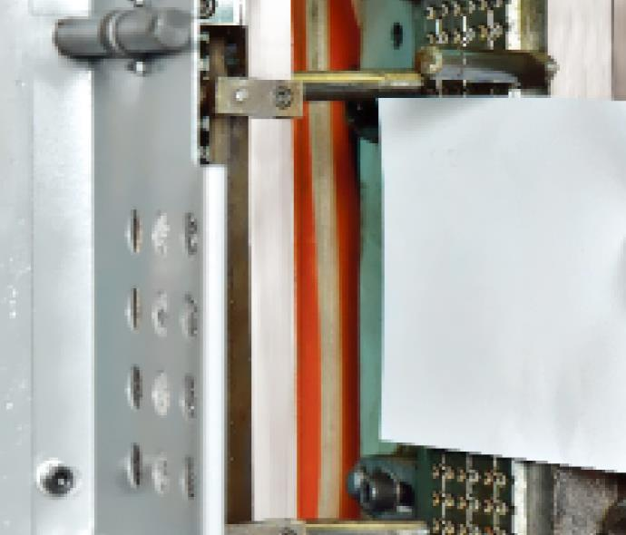
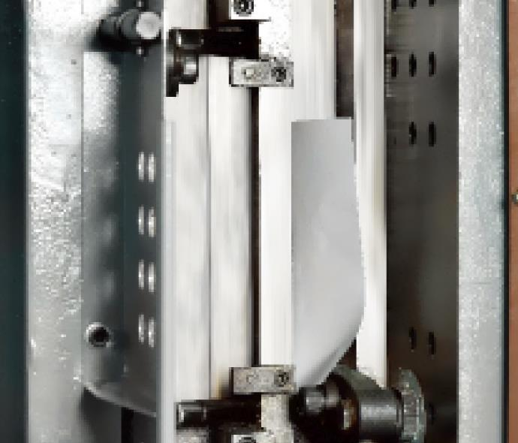
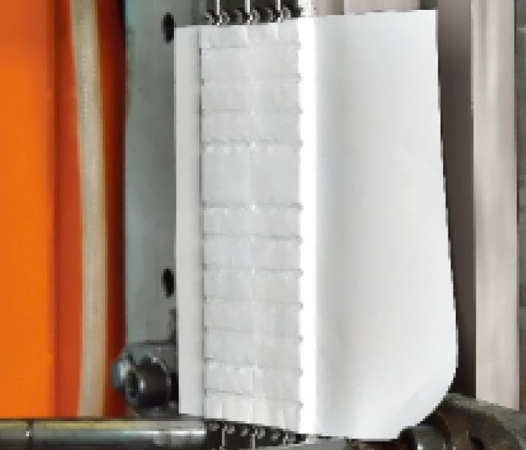
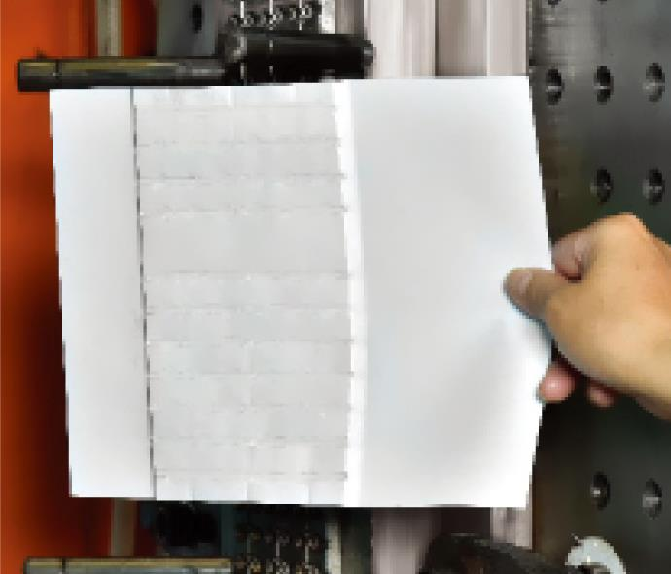
MK6 – “A4” Mould Protection Feature
Place sheet of A4 paper inside clamp
Close clamp at 99% speed & pressure!
MK6 delivers the ultimate in mould protection – a single sheet of A4 paper, at 99% clamp speed and pressure settings
Precision Hydraulics® at works here
XX-II/IIS has no equivalent mould protection feature
Clamp bounces open and alarm sounds
Inspect paper: it is not even punctured through!

Slide 32
Reopening a Locked Clamp
Locked Period | Model | XX1600II | XX1600IIS | JM168-MK6
1 hour | Pressure | 140 bar | 150 bar | ＜100 bar
 | Status | Large noise Hard vibration | Large noise Hard vibration | Silky Smooth
60 hours | Pressure | 140 bar | 150 bar | ＜100 bar
 | Status | Large noise Hard vibration | Large noise Hard vibration | Silky Smooth

Slide 33
Opening Stroke
450
mm
Bigger numbers are better
Larger opening strokes enable production of deep-cavity parts
430
mm
430
mm
XX1600II
XX1600IIS
JM168-MK6

Slide 34
Minimum Mould Height
180
mm
180
mm
Smaller numbers are better
Smaller minimum moulding height enables production of thin-walled parts
170
mm
XX1600II
XX1600IIS
JM168-MK6

Slide 35
Ejector Force
4.2
ton
Bigger numbers are better
Larger ejector force enables production of deep-cavity/extra-long parts
3.3
ton
3.3
ton
XX1600II
XX1600IIS
JM168-MK6

Slide 36
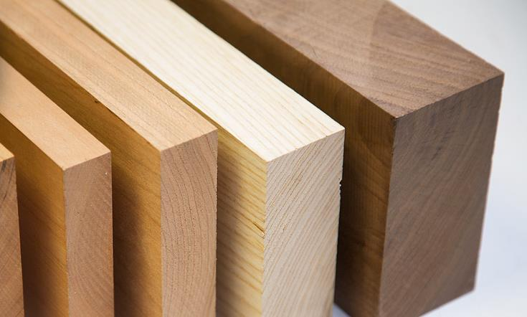
Mould Adj. Performance
Comparisons of Specs &
Actual Measurements
INTERNAL ONLY

Slide 37
Automatic Clamping Force Adjustment
Due to complex non-linear relationship between clamping pressure and clamping force, achieving accurate clamping force usually requires experience and certain “black arts”
MK6 allows intelligent automatic adjustment of clamping force (at the time expense of 1 second), eliminating guess-work and the needs for experts
Model | Time Needed | Set Clamp Force | Set Clamping Pressure
JM168-MK6 | 29 sec. |  | not needed
XX1600II | 27 sec.
XX1600IIS | 28 sec.

Slide 38
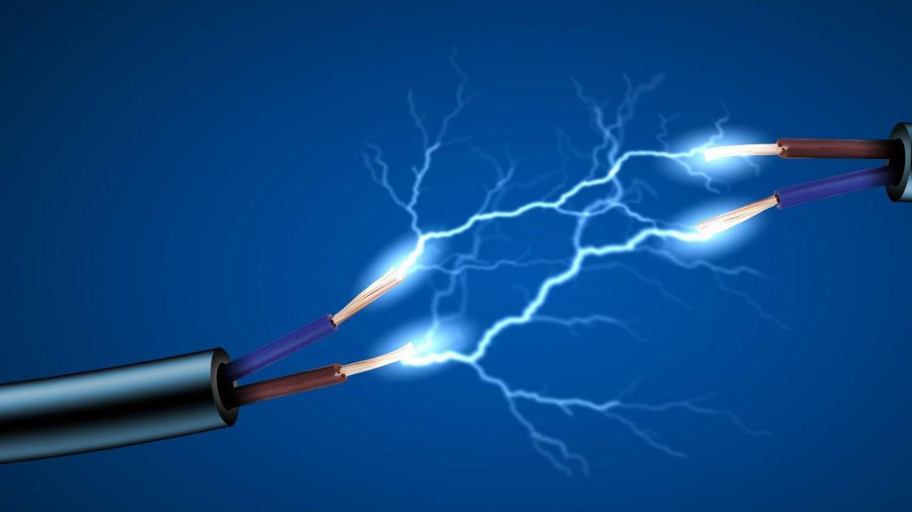
Electricals
Comparisons of Specs &
Standards
INTERNAL ONLY

Slide 39
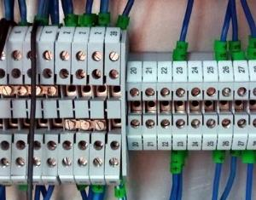
Low-Voltage Terminals
XX1600II
XX1600IIS
JM168-MK6
traditional
terminals
traditional
terminals
CE-standard
spring-type terminals

Slide 40
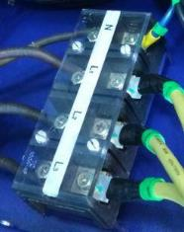
Power Connection Terminals
XX1600II
XX1600IIS
JM168-MK6
normal terminals
not compliant
to safety regs
normal terminals
not compliant
to safety regs
CE-compliant terminals

Slide 41
Power Pack
Comparisons of Specs
INTERNAL ONLY

Slide 42
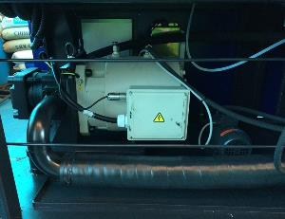
Maxiumum Sustainable Power Output
low power (15kW)
slow, low power (15kW)
Fast, High Power (22kW)
XX1600II
XX1600IIS
JM168-MK6
Pump: 64cc (China)
Servo: self-made
Max. power: 15kW
Pump: 50cc (China)
Servo: self-made
Max. power: 15kW
Pump: 64cc (Germany)
Servo: Phase, Innovance
Max. power: 22kW

Slide 43
Impact of Maximum Power Output on Application Processes
Different applications require different power outputs (e.g. engineering resins and thin-walled parts require more power)
If process power demand exceeds servosystem limit, alarm is tripped and machine stops
Energy efficiency drops significantly when power output is close to limit
Notes: As a servo-pump system can achieve 0 rpm, ACTUAL energy consumption is NOT related to max. power limit
Power Demand by Process | 5kW | 10kW | 15kW | 20kW
JM168-MK6
XX1600II |  |  | not energy efficient! | trips alarm!
XX1600IIS |  |  | not energy efficient! | trips alarm!

