Slide 1
Welcome!

Slide 2
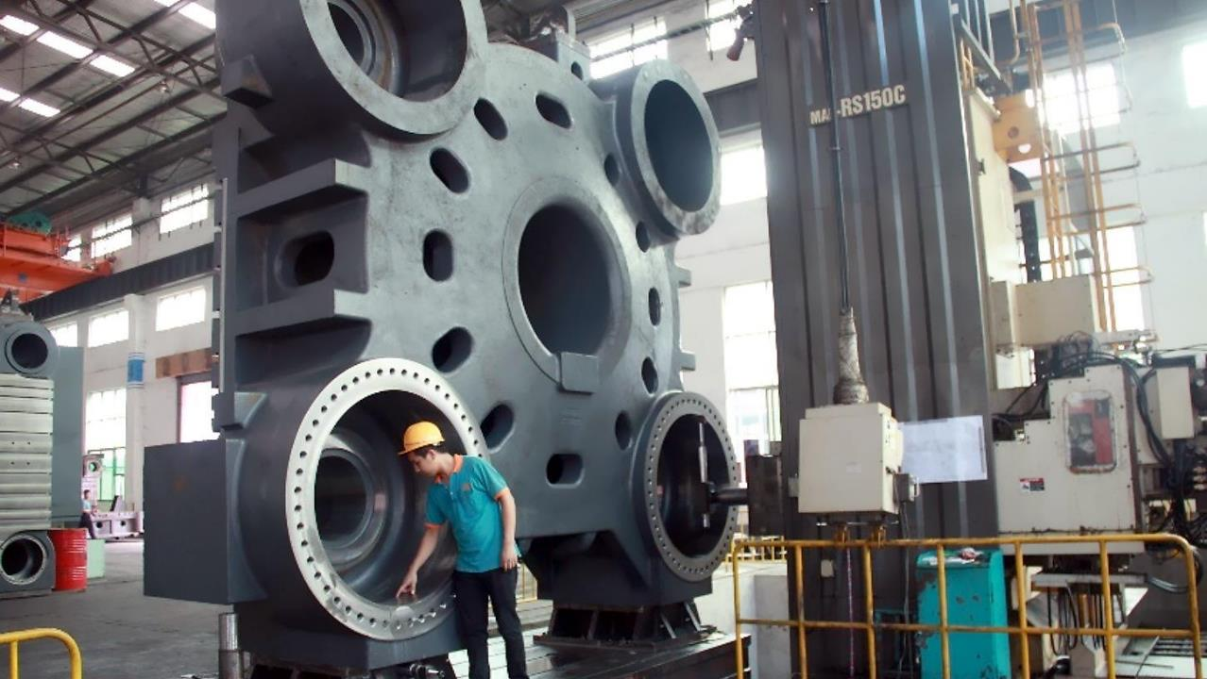
SUPERMASTER TWO-PLATEN

Slide 3
Benefits of True Two-Platen Design
Long Opening Stroke – Extendable
Small Footprint
Uniform Clamping Force Distribution, Stable Under Temperature Changes
Accurate Mould Open Force
Superior Part Quality
Superior Repeatability
Superior Mould Protection

Slide 4
Largest Opening Stroke
 | Min. Stroke (m) | Max. Stroke (m)
SM2200-TP | 1,600 | 2,500
XX24000II (toggle) | 1,370
SM2600-TP | 1,900 | 2,800
XX28000II (toggle) | 2,000
SM3000-TP | 2,100 | 3,000
XX33000II (toggle) | 2,150
SM3600-TP | 2,200 | 3,200
XX40000II (toggle) | 2,250

Slide 5
Smallest Footprint
 | Machine Length | Footprint Reduction
SM2200-TP | 12.3m
JM1850-C3 (toggle) | 14.8m | -16.9%
JM2000-C3 (toggle) | 17.4m | -29.3%
XX20000II (toggle) | 15.8m | -22.2%

Slide 6


Uniform Clamping Force Distribution
All four tie-bars must convey the same clamping force for best part quality without flashes and internal stresses
Two platen machines guarantee absolute clamping force uniformity
Uniform clamping force is difficult to achieve in a toggle machine
Toggle
Toggle
Two-Platen
> 10%
1-10%
< 1%

Slide 7
Clamping Force Unaffected by Temperature
low temperature: narrower
high temperature: wider
Excessive clamping force causes undue wear on tie-bars, reducing life of machine as well the mould
Toggle clamping force : 300 tons
Two-Platen clamping force : 300 tons
Toggle clamping force : 380 tons!
Two-Platen clamping force : 300 tons

Slide 8
Accurate Opening Force
Toggle
Two-Platen
Mould opening magnified via toggle mechanism
Difficult to control and imprecise
Mould opening via hydraulic cylinders
Accurate and precise force

Slide 9
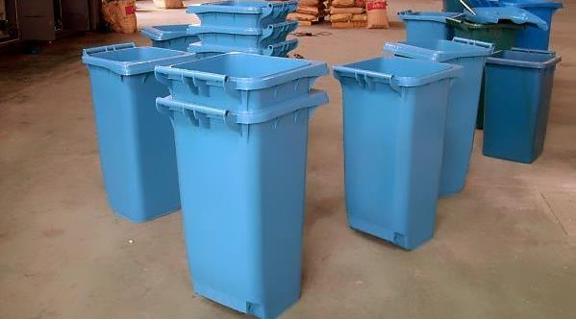
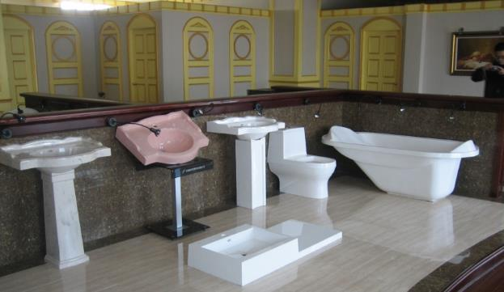
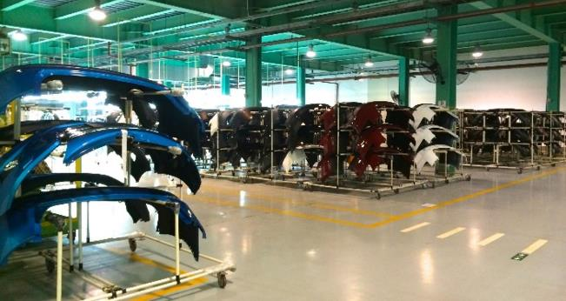
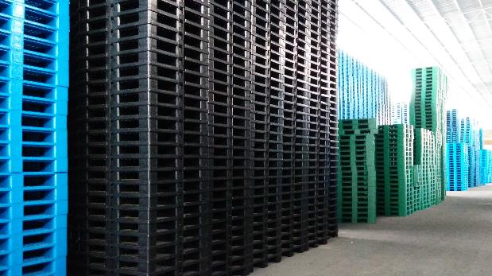
Two-Platen – A Machine for All Occasions

Slide 10
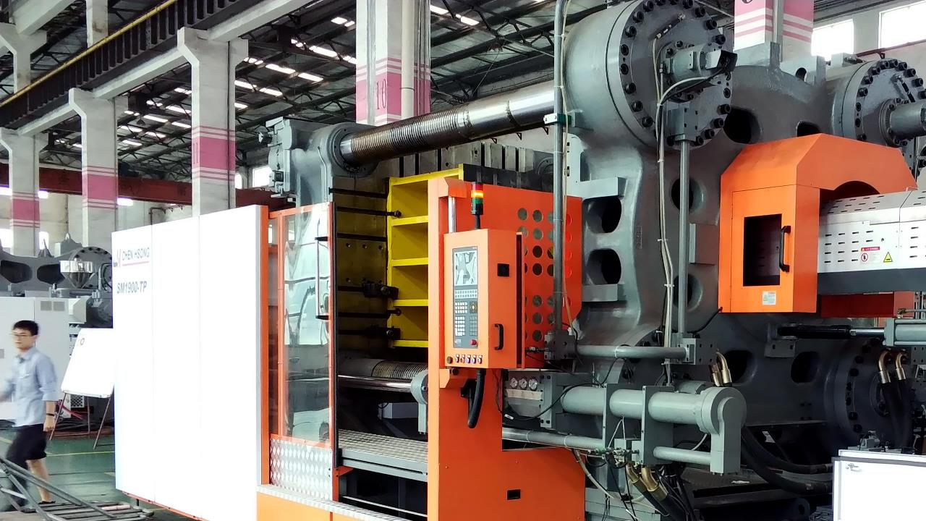

Supermaster Two-Platen
A Brief History of Japanese
Technology and
Cooperation

Slide 11
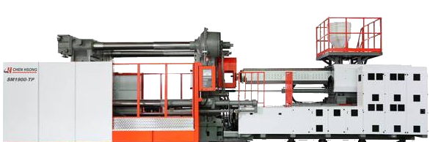
The SUPERMASTER TP Advanced Series

Slide 12
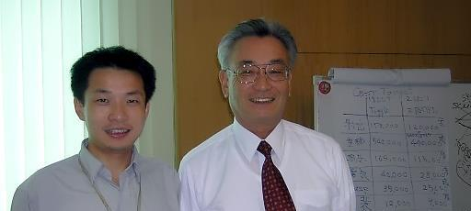
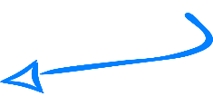

2006 – Project Started by Mr. Shioda ex Chief Engineer, Mitsubishi
SHIODA Sensei
He is now much older, and wiser!

Slide 13
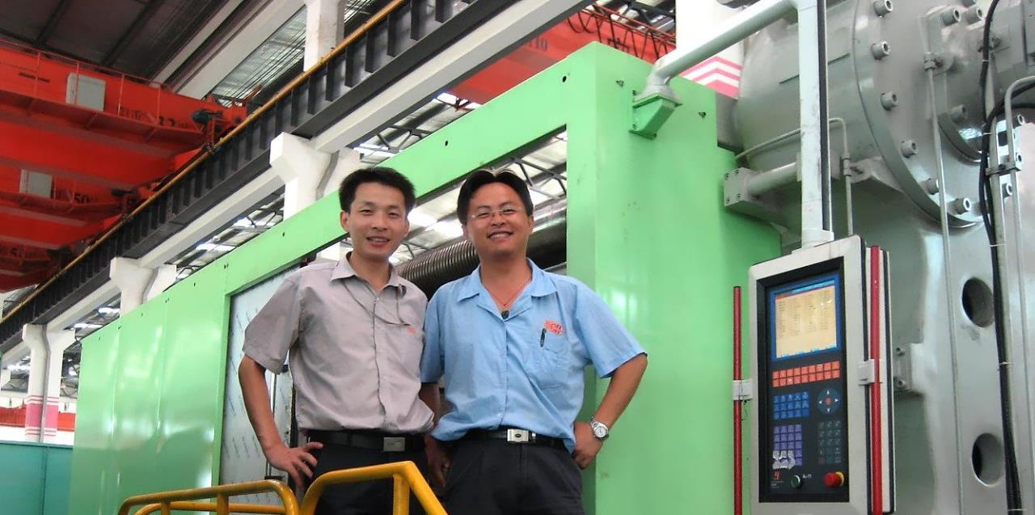
2007 – First True Two-Platen in China

Slide 14
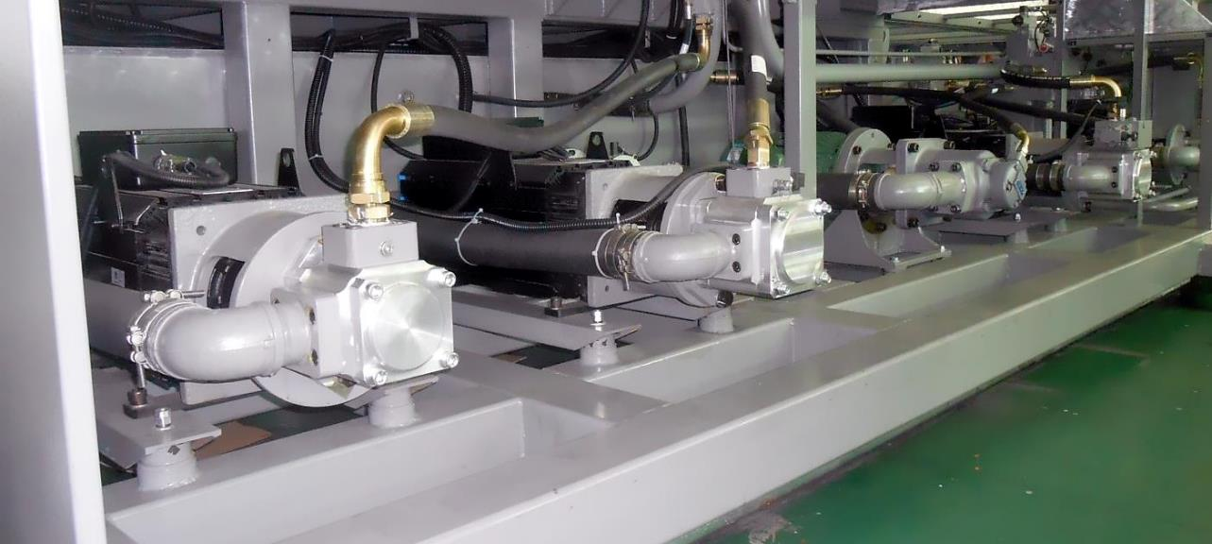
2009 – First Servo-Driven Two Platen

Slide 15
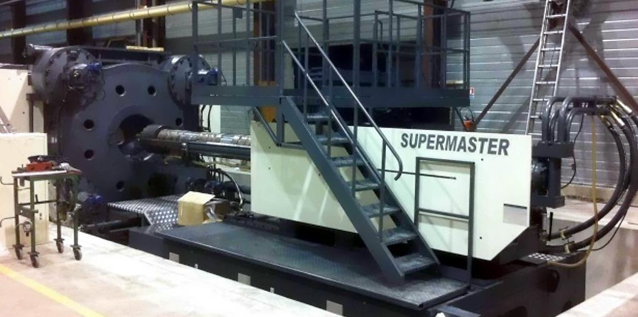

2010 – SM2600-TP in FRANCE

Slide 16
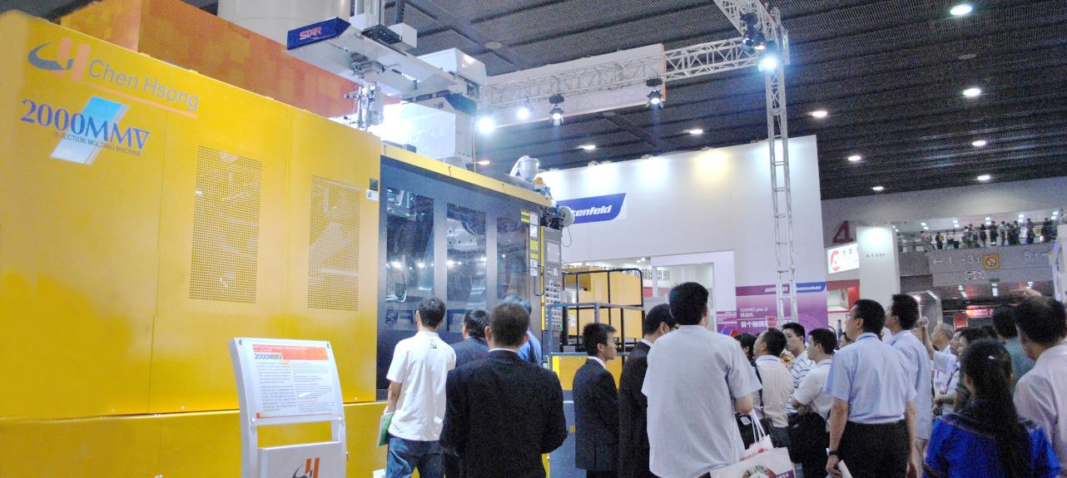
2011 – Mitsubishi 2000MMV made by Chen Hsong
ChinaPlas 2011

Slide 17
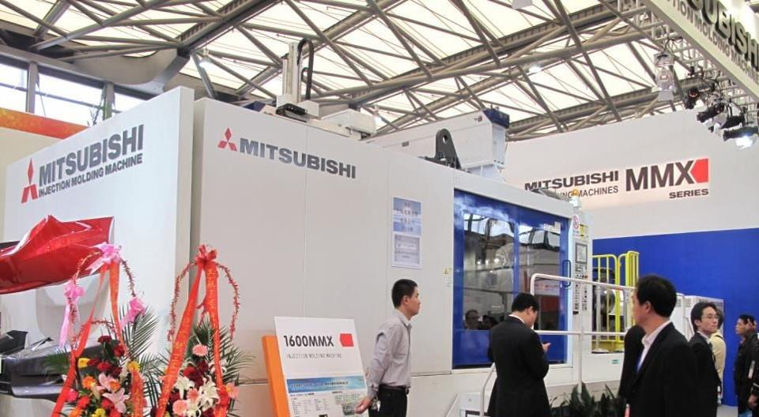
2012 – Mitsubishi 1600MMX made by Chen Hsong
ChinaPlas 2012

Slide 18
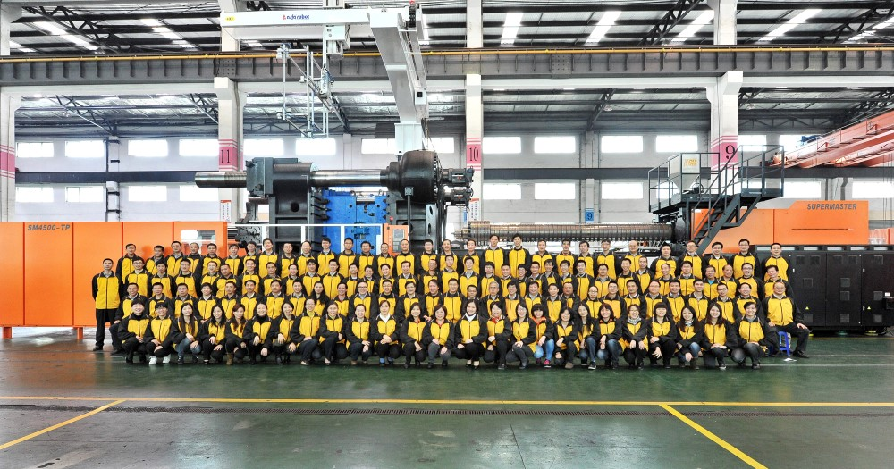
2012 – SM4500-TP to EUROPE

Slide 19
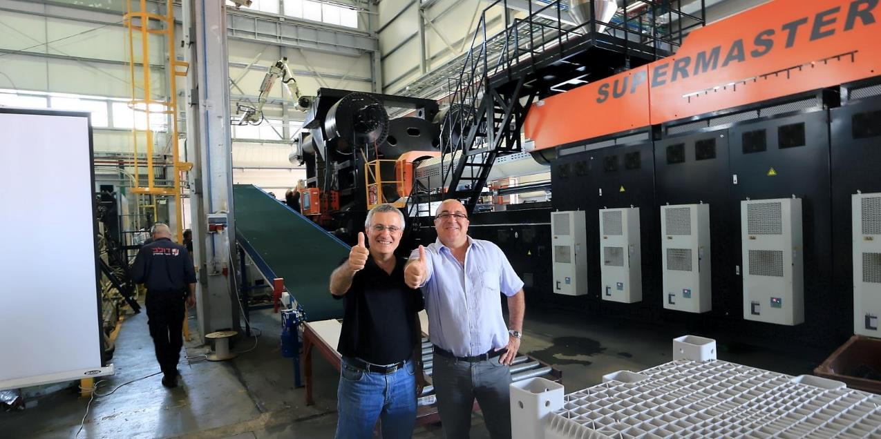
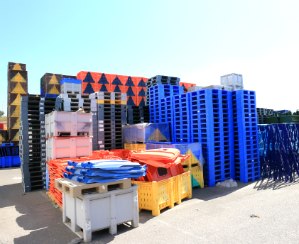
2013 – SM6500-TP to ISRAEL

Slide 20
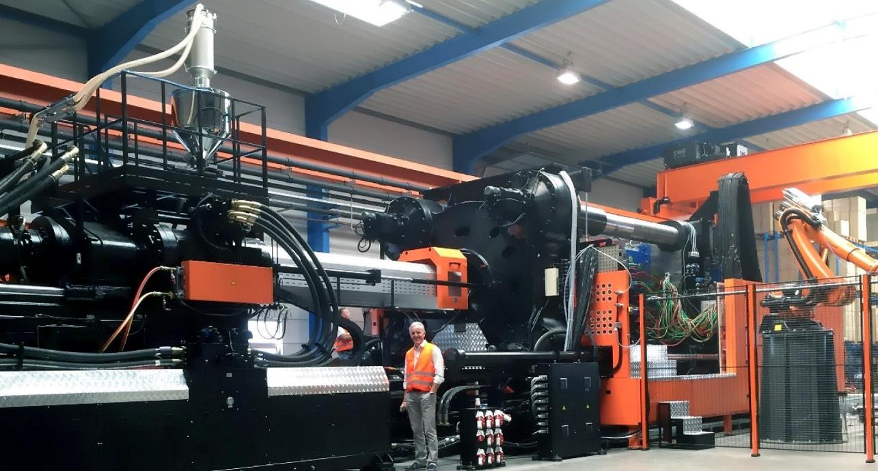
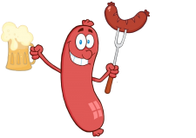
2015 – SM3600-TP to GERMANY

Slide 21
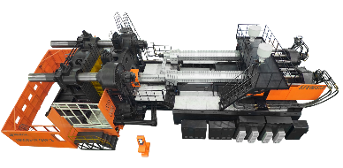

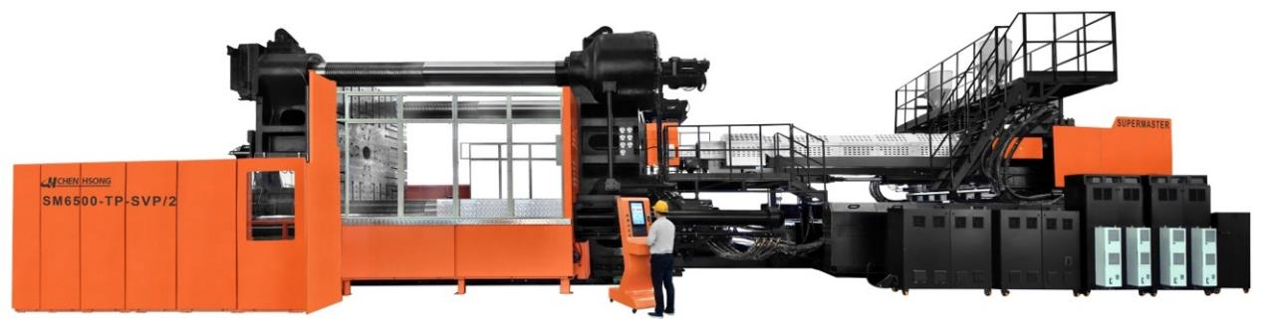
2016 – SM6500-TP to AUSTRALIA
Innovative Y-Injectors!

Slide 22
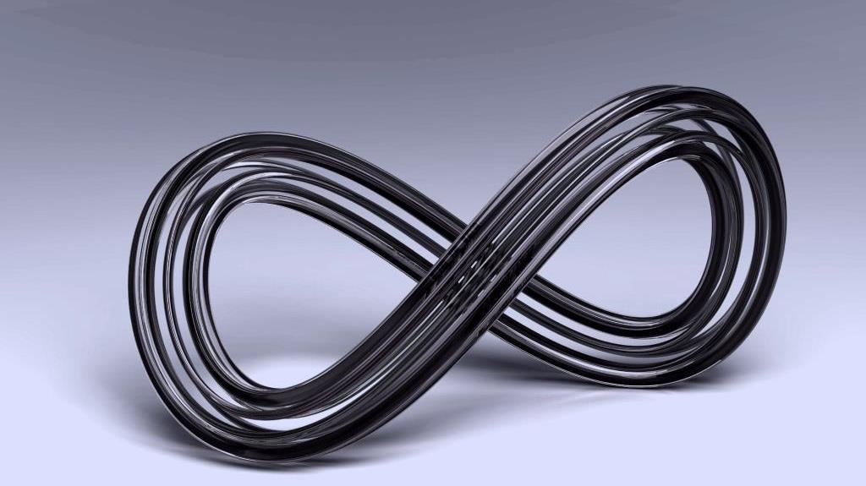

Non-Stop™ Technology
Eliminates Unscheduled
Down-time

Slide 23

Why Does Unscheduled Down-Time Happen?
Wear-and-tear on mechanics
Component quality degrades
Inability of control system to adapt to machine condition
Operator error
Down-Time = Headache

Slide 24

Foundations of Long-Term Stability
The Philosophy of Not-Making-Things-Worse
Precision Hydraulics® turn all mechanical motions to silky smoothness, reducing unnecessary wear-and-tear
Rock Solid Machanics
Patented Japanese mechanical design allows for superior performance while maintaining machine at top shape
Dynamic Control Systems
Adapts to changes in real-time for smooth, shocks-free mechanical motions

Slide 25


What a Difference Precision Makes
Precision Hydraulics®

Slide 26
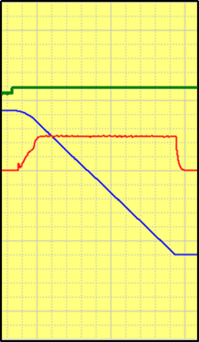
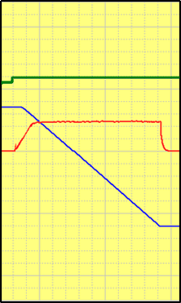
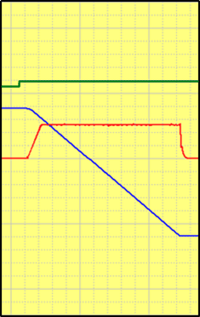

Injection Speed Response (0 → 99%)
300ms
320ms
220ms
Injection speed response curves from 0-99%
Smaller numbers are better
Look for: smoothness, no fluctuations, no overshoots
Command
Normal
Normal
Precision
Hydraulics™
Actual Speed
Position

Slide 27



Injection Pressure Control
Look for: smoothness, no fluctuations, no overshoots
Injection pressure control is vital to ultimate part quality
Special materials (e.g. engineering resins) are particularly sensitive to pressure fluctuations
Stable injection pressure has a definitive impact on yield rates
Normal
Normal
Precision
Hydraulics™

Slide 28
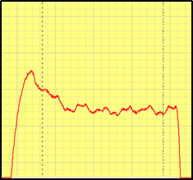
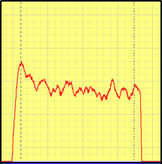
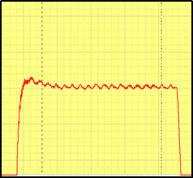
General Pressure Control
Look for: smoothness, no fluctuations, no overshoots
Most machines have low quality pressure control – i.e. high fluctuations and overshoots
Precision Hydraulics® yields precise pressure control
Precise pressure control is vital for demanding, pressure-sensitive applications such as optical parts
Normal
Normal
Precision
Hydraulics™

Slide 29
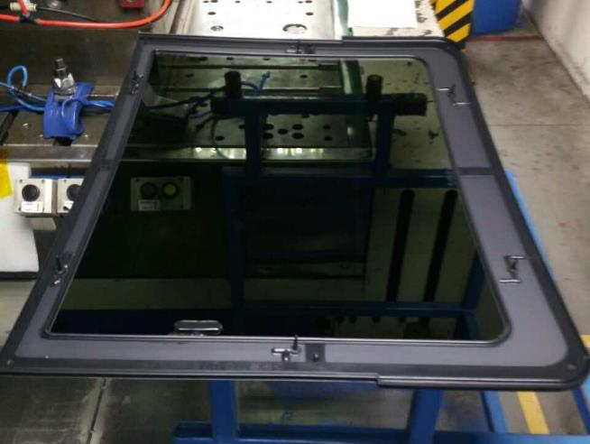
Case: Automotive Glass Rimming
World’s largest supplier of automotive glass asked for a way to put plastic rims around glass panels
An SM1050-TP with Precision Hydraulics® successfully rose to the challenge

Slide 30
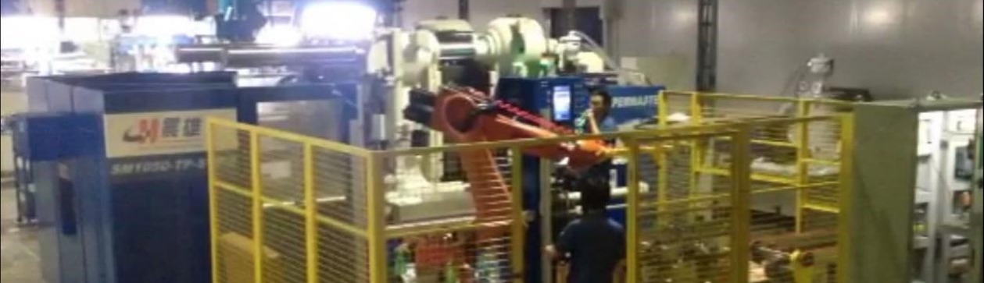
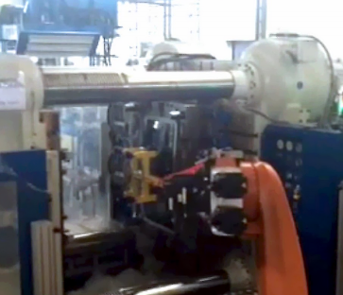
Automotive Glass-Rimming Solution
Cycle time : 90s to 55s
Yield : 95% to 99%
Repeatability within ±0.1%

Slide 31
Precision Hydraulics®
Precision at HIGH SPEED
(sustainable fast platen movements and injection)
Next-Gen computer control algorithms and hydraulics circuit design
Developed by senior Japanese engineers with decades of technical expertise, using advanced hydraulics simulation software
Enhancement of 3rd Gen Servo-Pump technology: from 3G to 4G
Eliminates unnecessary pressure drops for ultimate precision
Rock-Solid Stability
(minimal vibrations and shocks even running at max. speed)
High Repeatability
(tolerances within 0.05%)

Slide 32


Ultimate Modularity
Flexible Mix ‘n Match
32

Slide 33

Mix ‘n Match the PERFECT Machine for YOU
14 Clamping Units
(700 – 6,500 tons)
29 Injection Units
(2 – 110kg shot weight)

Slide 34
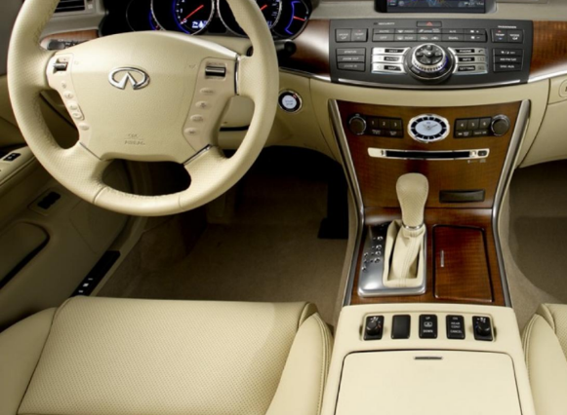
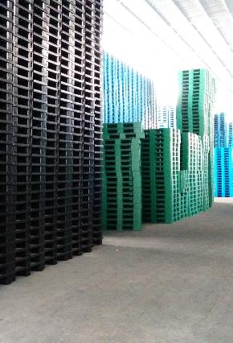

The Right Machine for the Right Job
Automotive
Pallets
Waste Bin
LARGE clamp, SMALL injection
LARGE injection
LARGE stroke

Slide 35



World-Class Design

Slide 36
Fast and Precise – Benefits of Advanced Japanese Mechanical Design
Example: SM1900-TP
Max Opening Speed | 750mm/sec.
Clamp Open | 2.8 sec.
Clamp Close | 3.8 sec.
Dry Cycle (EU6) | 6.6 sec.
Opening Stroke | 1,170mm
Mould Open Position | ±0.1mm

Slide 37
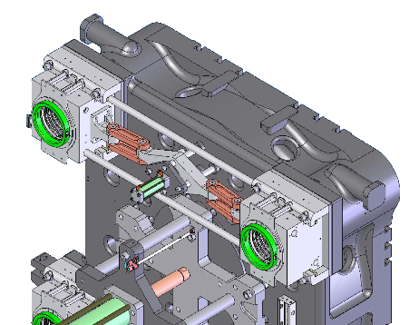
Patented Inter-Locking Mechanism
Pure Mechanical
Fast
Smooth
Noiseless
Reliable
Synchronous
Patent no.
ZL 2007201514065

Slide 38
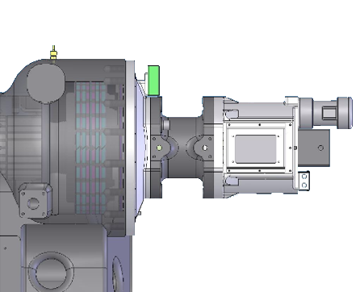
Patented Stopper Mechanism
Pure Mechanical Design
Very Fast & Very Reliable
Patent no.
ZL 200720151407X

Slide 39
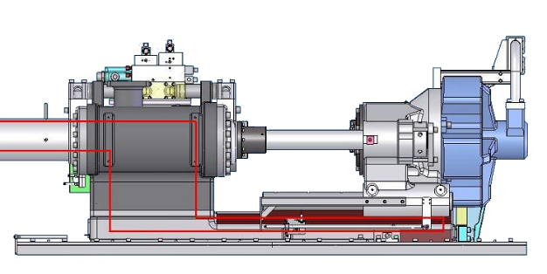
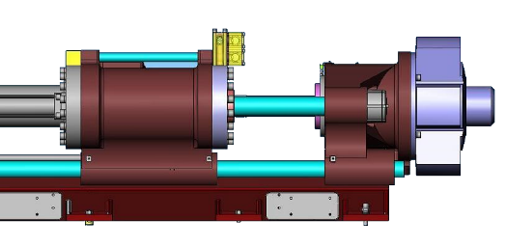
Injection Unit Design Guarantees Alignment
Others
SM-TP
C.G.
torque
C.G.
Not aligned
Guaranteed in-line
(tolerance = 0.07mm)

Slide 40
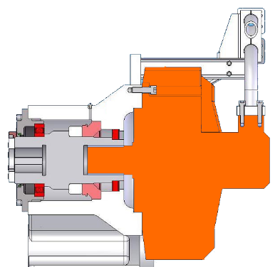
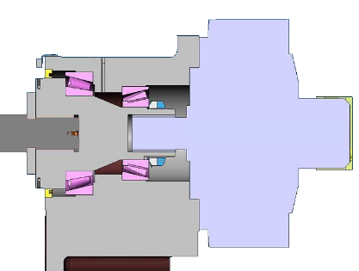
Guaranteed Alignment for Hydraulic Motor
Others
SM-TP
Traditional design easily
subject to distortion
Three bearings
guarantee alignment

Slide 41
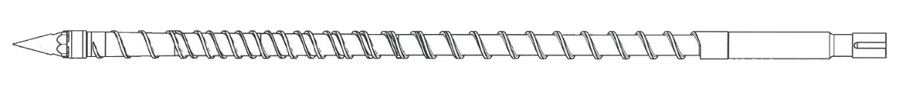
All-Purpose Barrier Screw Design
Japanese barrier screw design for wide applications window and superior melt quality
Very high precision for wide range of resins
(up to ±0.3%)

Slide 42
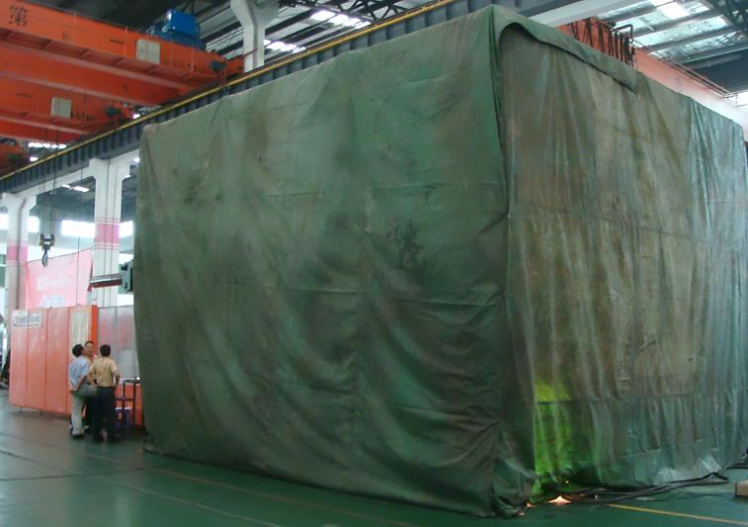
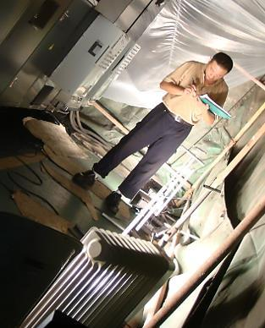
50°C High Heat Stress Test

Slide 43
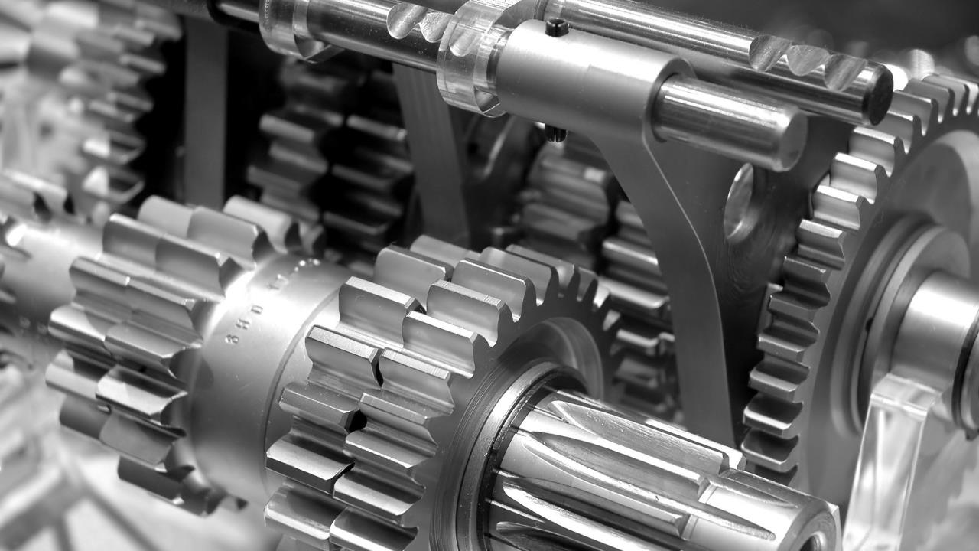
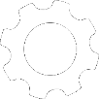
Advanced Options
Special Solutions
for Special Applications

Slide 44
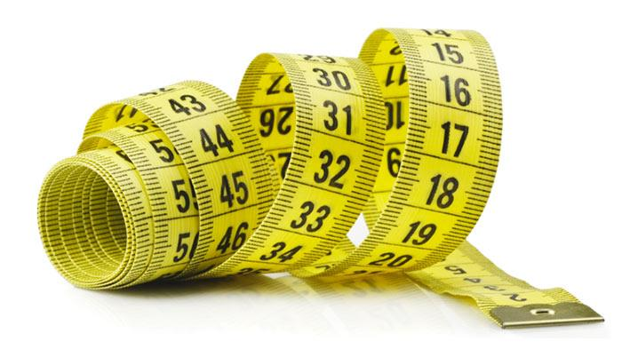
Extendable Stroke
Option

Slide 45
Stroke Can Be Lengthened in
Standard Steps of 300mm
Standard Stroke
Standard + 300mm
Standard + 600mm
Standard + 900mm

Slide 46
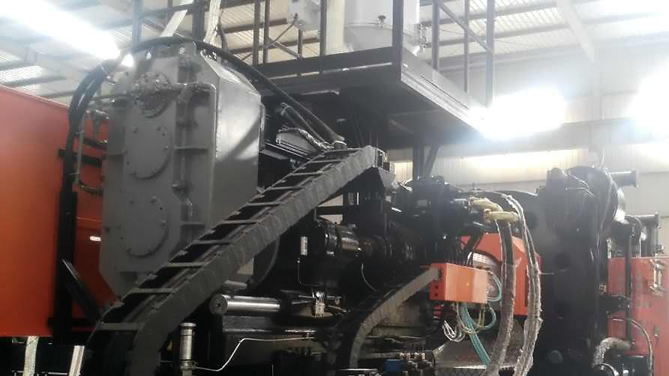
e-Drive
Servomotor parallel plasticizing
Option
saves cycle time
saves energy
silent operation

Slide 47
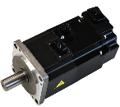
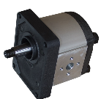
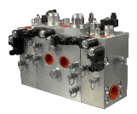
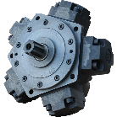

Energy Efficiency Comparisons – e-Drive
pump
hydraulics
motor
servomotor
hoses
hoses
Normal
95%
x
93%
98%
92%
= 77%
x 98% x
x 98% x
servomotor
gear-
box
e-Drive
Note: Plasticizing typically consumes the most energy in an injection moulding machine
95%
x
95%
= 90%

Slide 48

Compressive Moulding
Option

Slide 49
Two-Stage Clamp Closing
clamp close
lock
injection
holding
recovery
release
clamp open
Stage 1 closing
leaves gap
tolerance < ±0.1mm
Stage 2 clamp closing
= Compressive Moulding
sequential injection
Precision Hydraulics™

Slide 50
Benefits of Compressive Moulding
High dimensional stability, especially for large, thin products
Reduce injection pressure
Reduce clamping force required
High product quality – low internal and residual stress
High good-part yield
High precision control on injection process
Enables over-moulding of sensitive materials (e.g. fabric)

Slide 51

Case Study: Automotive Fabric Over-Mould
Audi Q5 seating part
Yield improved from 93% to 99% due to reduced internal stress
Cycle time reduced from 120s to 70s
No post-processing step necessary

Slide 52

Extractable
Tie-bar
Option

Slide 53

Benefits of Extractable Tie-Bar
Perfect for low ceiling clearance
Faster mould changes
Tie-bar is only extracted during mould change – not during normal operations

Slide 54

Y-Injectors or…
Two is better than one
Option

Slide 55

For very SMALL and very LARGE parts

Slide 56

Unparalleled Flexibility
Shoot on one injection unit for smallest shot weight
Shoot on both for largest shot weight
Shoot one barrel, then the second
Shoot both together
Shoot both, staggered, with different profiles
Two different colors and/or materials…, more than two injectors…
Two Injection Units, One Shot!

Slide 57


12kg Part on a 120kg Injection Unit!
Siemens MRI

Slide 58

MuCell®
Physical microcellular foaming
Option

Slide 59


Slide 60
A Typical MuCell® Setup

Slide 61



Microcellular Foaming Principle

Slide 62




What Can MuCell® Do?
GF
Super-large, Super-flat, Super-Long
Large thickness deviation
Reduce weight
by 10-15%
Traditional
With MuCell®

Slide 63
Case: SM3000-TP MuCell® Core-Back
Part: Tesla Model-S Instrument Panel
Clamping
Injection
Core Back
starts opening the mould to 0.5-1mm during injection
Precision required: ±0.05mm
Precision Hydraulics™

Slide 64



Remember These
Non-Stop™ Technology & Precision Hydraulics®
FAST Cycle and HIGH Reliability
High Energy Efficiency
Unparalleled Flexibility
64

