Slide 1
MK6 vs XX-A5 (Internal Confidential)

Slide 2
Measured Performance
Specifications vs Actual Measured
INTERNAL ONLY

Slide 3
Summary Scoring
Model | General | Electricals | Hydraulics | Mechanics | Total Score
JM168-MK6 |  |  |  |  | 16
XX160-A5 |  |  |  |  | 5

Slide 4
Highest Actual Measured Speed for All Specifications at 99% Settings
MK6 has a all-rounded speed advantage
XX-A5 is slightly faster in plasticizing rpm (but at the expense of very low torque due to much smaller hydraulic motor)
 | 单位 | XX160-A5 | JM168-MK6
Max. Clamp Closing Speed | mm/s | 768 | 817 (+6%)
Max. Clamp Opening Speed | mm/s | 1,242 | 1,313 (+6%)
Max. Injection Speed | mm/s | 98 | 108 (+10%)
Max. Plasticizing Speed | rpm | 233 | 224 (-4%)
Max. Mould Adj. Speed | mm/s | 1.7 | 2.5 (+50%)

Slide 5
What Makes The Difference
Precision Hydraulics®
for the MK6

Slide 6
Precision Hydraulics®
Precision at HIGH SPEED
(JM168-MK6 has sustainable dry cycle of only 1.9s)
Next-Gen computer control algorithms and hydraulics circuit design
Developed by senior Japanese engineers with decades of technical expertise, using advanced hydraulics simulation software
Enhancement of 3rd Gen Servo-Pump technology: from 3G to 4G
Eliminates unnecessary pressure drops for ultimate precision
Rock-Solid Stability
(little vibrations and shocks even running at max. speed)
High Repeatability
(tolerances < 0.05%)

Slide 7
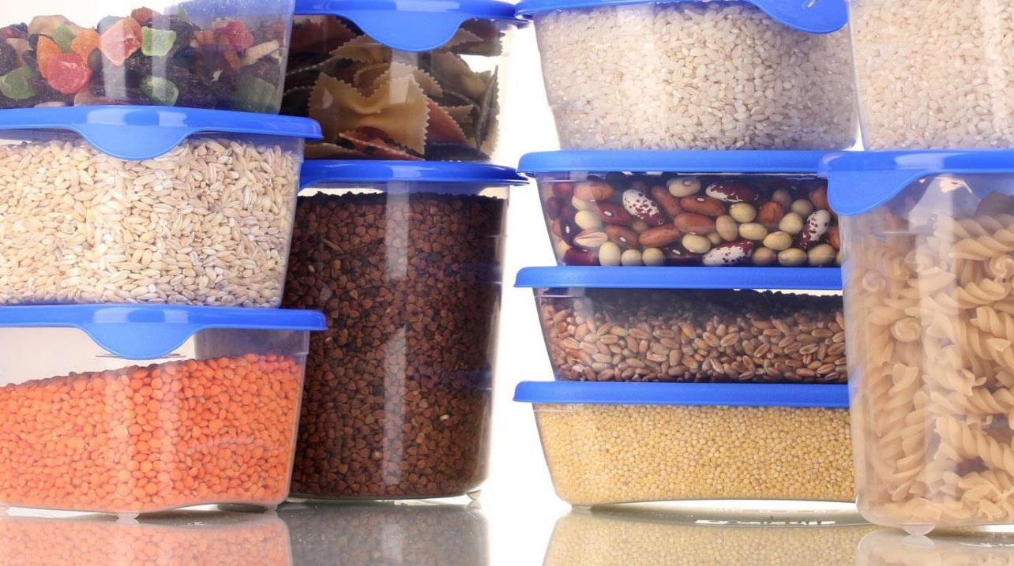
Injection Performance
Comparisons of Injection Specs &
Actual Measurements
INTERNAL ONLY

Slide 8
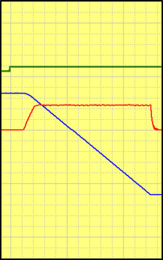
Injection Speed Response (0 → 99%)
520ms
220ms
Injection speed response curves from 0-99%
Smaller numbers are better
Look for: smoothness, no fluctuations, no overshoots
Command
XX160-A5
JM168-MK6
Speed
Position

Slide 9
The Importance of Speedy Response
JM168-MK6
XX160-A5
Notes
Response is similar to a sports car – 0-100kph acceleration time
Smooth rides at high speed demands quick responses
Snappy responses reduce cycle times, increase productivity
Quick responses are particularly beneficial to difficult or thin-walled moulding processes
Speed
(0 → 99%)
220ms
520ms
Time

Slide 10
Injection Pressure Control
Look for: smoothness, no fluctuations, no overshoots
Injection pressure control is vital to ultimate part quality
Special materials (e.g. engineering resins) are particularly sensitive to pressure fluctuations
Stable injection pressure has a definitive impact on yield rates
MK6 has superior pressure control
XX160-A5
JM168-MK6

Slide 11
Injection Base Pressure and Pressure Drop
Smaller numbers are better
Base pressure and pressure drops are non-work wasted energy dispersed as heat, requiring even more energy to cool
High base pressure or pressure drops leads to significantly lower power efficiency and energy saving
MK6’s Precision Hydraulics® all but eliminates pressure drops and has very low base pressure
24
Lose
55%
Pressure
Drop (bar)
20
10
Base
Pressure
(bar)
Base
Pressure
(bar)
XX160-A5
JM168-MK6

Slide 12
Injection Pressure
188
MPa
15%
Bigger numbers are better
Higher injection pressure means better and more consistent part quality
163
MPa
XX160-A5
JM168-MK6

Slide 13
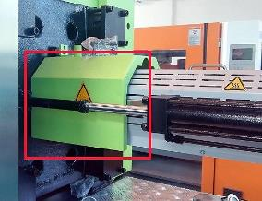
Nozzle Protection Guard
no window
Window
XX160-A5
JM168-MK6
not convenient
Easy to operate

Slide 14
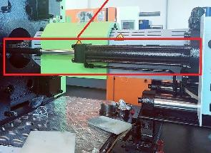
Injection Carriage Cylinders
horizontal dual
balanced
Diagonal
Dual Balanced
XX160-A5
JM168-MK6
not convenient when working on nozzle
Easy to operate on nozzle

Slide 15
Injection Base
traditional guide rods
Linear Rails
XX160-A5
JM168-MK6
not designed for
high-speed injection
Smoothness for
high-speed injection

Slide 16
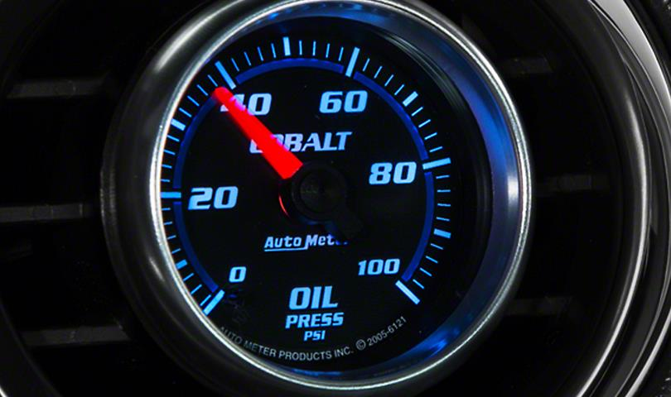
Holding Performance
Comparisons of Holding Specs &
Actual Measurements
INTERNAL ONLY

Slide 17
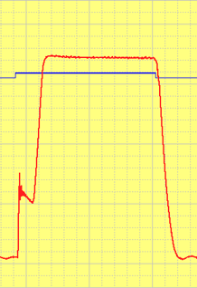
Holding Pressure Response (0 → 99%)
490ms
270ms
Holding pressure response curves from 0-99%
Smaller numbers are better
Look for: smoothness, no fluctuations, no overshoots
Stable holding pressure is vital to part quality and high yield
XX-A5 experiences significant overshoots and instabilities
XX160-A5
JM168-MK6
Pres.
Cmd.

Slide 18
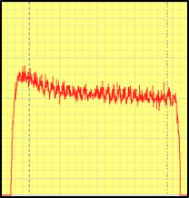
Pressure Control
Look for: smoothness, no fluctuations, no overshoots
XX-II/IIS have lower quality pressure control – i.e. high fluctuations and overshoots
MK6’s innovative Precision Hydraulics® technology yields precise pressure control
Precise pressure control is vital for demanding, pressure-sensitive applications such as optical parts
XX160-A5
JM168-MK6

Slide 19
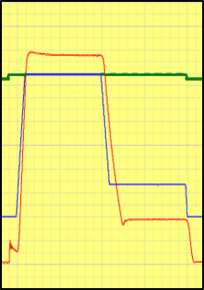
V/P Switch-Over Response
Patented
Technology
Look for: smoothness, no fluctuations, no overshoots
Precise and stable V/P switch-over is vital for demanding applications requiring precise dosing
Injection Command
XX160-A5
JM168-MK6
Actual Pressure
Pressure Command

Slide 20
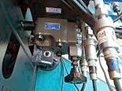
Back Pressure Control
manual
Digital
XX160-A5
JM168-MK6
not convenient slow and inaccurate
Easy, fast, accurate

Slide 21
Plasticizing Performance
Comparisions of Specs &
Actual Measurements
INTERNAL ONLY

Slide 22
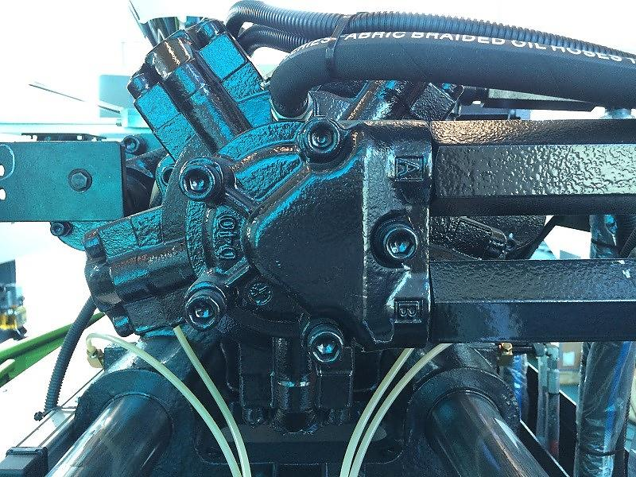
Plasticizing Motor Size and Torque
weak!
Fast and Strong
XX160-A5
JM168-MK6
Size: 400cc
Unit torque: 56 Nm
Size: 500cc
Unit torque: 80 Nm

Slide 23
Plasticizing Torque
Model | Screw Diam. | Flow Rate | Unit Torque | Max. Pressure | Max. Torque
JM168-MK6 | 46mm | 500cc | 8 | 175 bar | 1,400
XX160-A5 | 48mm | 400cc | 5.6 | 175 bar | 980
30%
Due to reduced power-pack of the XX-A5, the hydraulic motor is artificially made smaller to maintain plasticizing speed, at the expense of very low torque (bad for engineering resins)

Slide 24
Max. Heater Power
12.9
kW
18%
Bigger numbers are better
Inadequate heating power reduces plasticizing quality and efficiency, lengthens cycle time
10.9
kW
XX160-A5
JM168-MK6

Slide 25
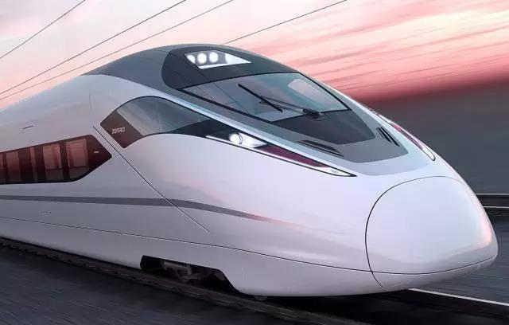
Clamp Performance
Comparisons of Platen and
Toggle Designs, Specs &
Actual Measurements
INTERNAL ONLY

Slide 26
Space Between Tie-bars
470 mm
460 mm
470 mm
460 mm
XX160-A5
JM168-MK6

Slide 27
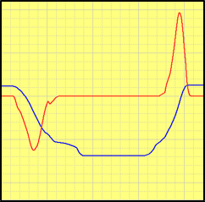
Dry Cycle Time
Japanese Hydraulic
& Mechanical Tech.
Smaller numbers are better
Look for: smooth motion, no fluctuations, no overshoots
MK6’s toggle mechanism and hydraulic circuit is based on advanced Japanese designs, enabling ultra-high speed operations
2.7 sec.
(+42%)
1.9 sec.
XX160-A5
JM168-MK6
Clamp Speed
Clamp Position

Slide 28
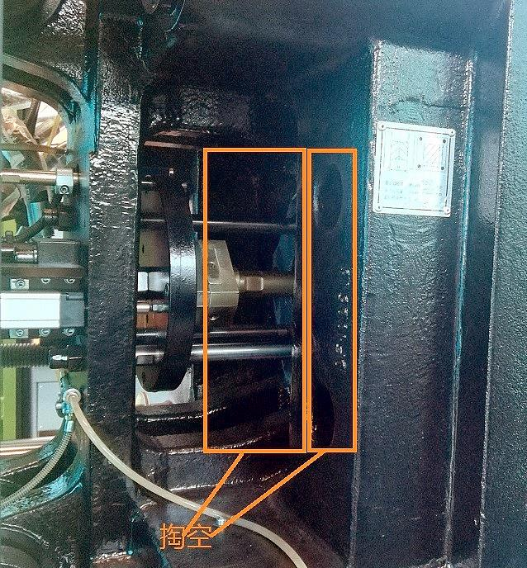
Platen Construction
large deformation
No Deformation
XX160-A5
JM168-MK6
Hollow inside
Actual thickness: 70mm
Solid inside
Actual thickness: 142 mm

Slide 29
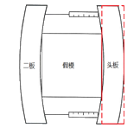
Platen Deformation
Smaller numbers are better
Large deformations can cause flashes
MK6 v.next will target <0.1mm deformation
0.314mm
0.15mm
XX160-A5
JM168-MK6

Slide 30
Uniformness of Tie-Bar Deformations
Japanese
Toggle Design
All four tie-bars must deform equally, or uniformly, for the best part quality without flashes and internal stresses
Only MK6’s special toggle design based on advanced Japanese technology guarantees absolute uniformity
XX160-A5
JM168-MK6
> 10%
1-10%
< 1%

Slide 31
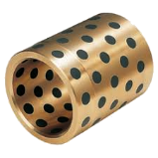
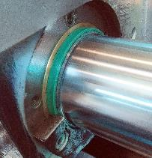
Bushings for the Moving Platen
Oil-less
Bushings
copper
XX160-A5
JM168-MK6
high friction
Smooth motion
Low friction

Slide 32
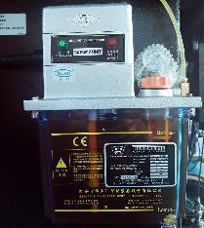
Lubrication Oil Sensor
poor detection
Perfect Detection
XX160-A5
JM168-MK6
sensor installed at pump limited detection
Sensor installed at application end

Slide 33
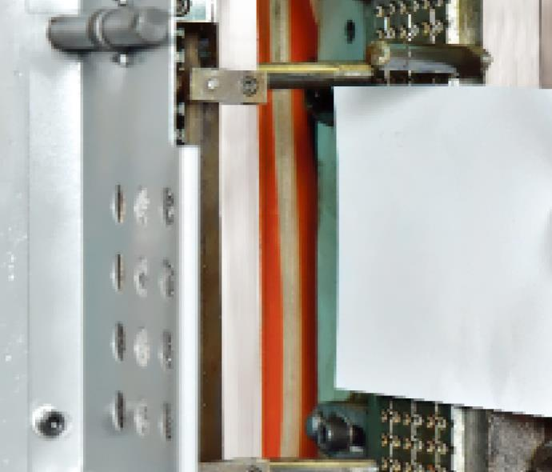
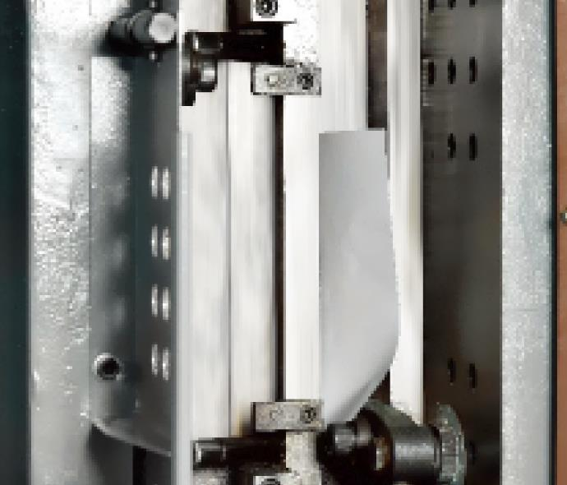
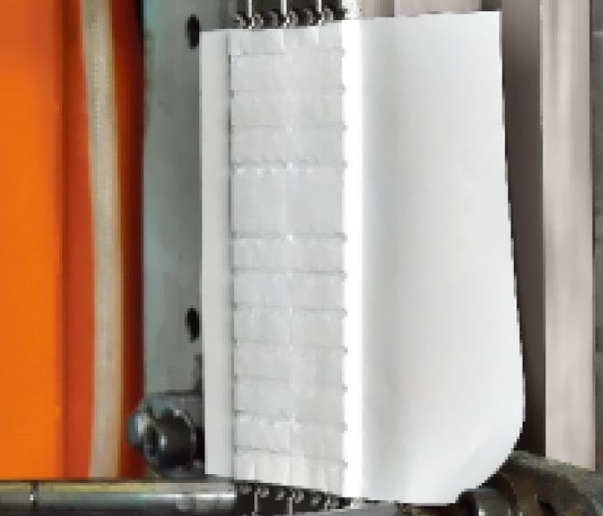
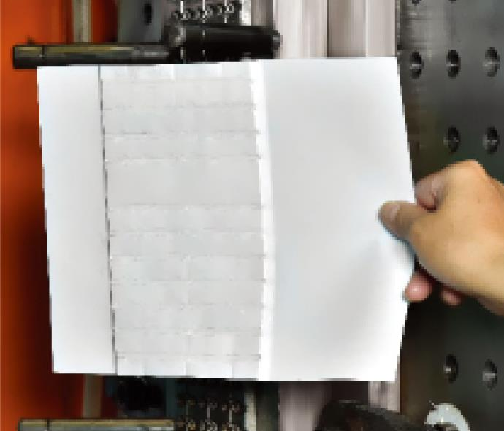
MK6 – “A4” Mould Protection Feature
Place sheet of A4 paper inside clamp
Close clamp at 99% speed & pressure!
MK6 delivers the ultimate in mould protection – a single sheet of A4 paper, at 99% clamp speed and pressure settings
Precision Hydraulics® at works here
XX-II/IIS has no equivalent mould protection feature
Clamp bounces open and alarm sounds
Inspect paper: it is not even punctured through!

Slide 34
Reopening a Locked Clamp
Locked Period | Model | XX160-A5 | JM168-MK6
1 hour | Pressure | >150 bar | ＜100 bar
 | Status | Large noise Hard vibration | Silky Smooth
60 hours | Pressure | >160 bar | ＜100 bar
 | Status | Large noise Hard vibration | Silky Smooth

Slide 35
Hydraulic Safety Valve
XX160-A5
JM168-MK6
no safety valve not compliant to safety regulations
Compliant to all safety standards

Slide 36
Opening Stroke
450
mm
Bigger numbers are better
Larger opening strokes enable production of deep-cavity parts
420
mm
XX160-A5
JM168-MK6

Slide 37
Ejector Force
4.2 吨
4.2 吨
Bigger numbers are better
Larger ejector force enables production of deep-cavity/extra-long parts
XX160-A5
JM168-MK6

Slide 38
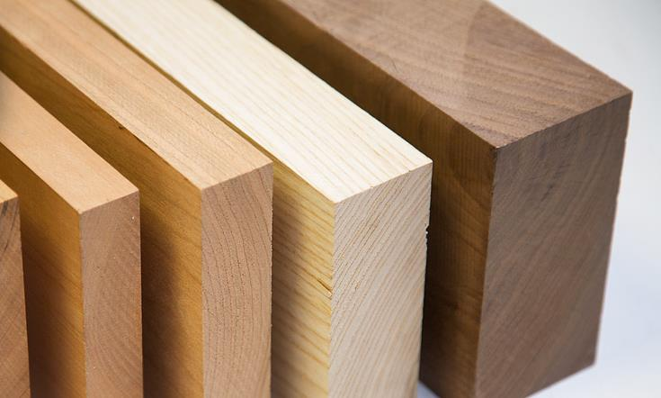
Mould Adj. Performance
Comparisons of Specs &
Actual Measurements
INTERNAL ONLY

Slide 39
Automatic Clamping Force Adjustment
Due to complex non-linear relationship between clamping pressure and clamping force, achieving accurate clamping force usually requires experience and certain “black arts”
Both allow intelligent automatic adjustment of clamping force
XX-A5 also requires measuring the mould’s actual thickness which is time-consuming
Model | Time Needed | Set Clamp Force | Measure Mould Thickness
JM168-MK6 | 29 sec. |  | not needed
XX160-A5 | 77 sec. |  | Must

Slide 40
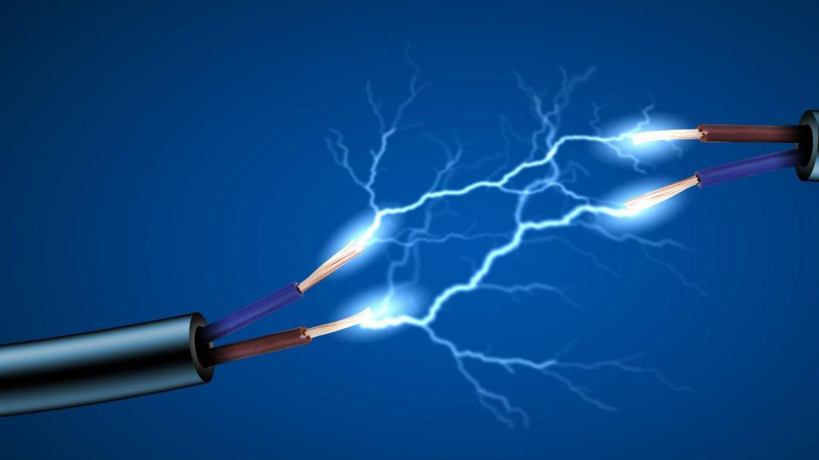
Electricals
Comparisons of Specs &
Standards
INTERNAL ONLY

Slide 41
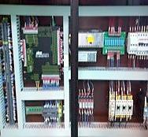
Electrical Cabinet
Resistant to
Interference
prone to interference
XX160-A5
JM168-MK6
traditional resin board
Galvanized sheet

Slide 42
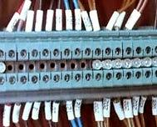
Low-Voltage Terminals
XX160-A5
JM168-MK6
traditional
terminals
CE-standard
spring-type terminals

Slide 43
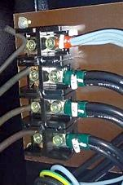
Power Connection Terminals
XX160-A5
JM168-MK6
normal terminals
not compliant
to safety regs
CE-compliant terminals

Slide 44
Safety Modules
XX160-A5
JM168-MK6
no safety module
not compliant to safety regulations
Pilz (Germany) Fully compliant to
safety standards

Slide 45
Nozzle Guard Safety Switch
XX160-A5
JM168-MK6
no safety switch
not compliant to safety regulations
Full Compliant to
Safety Standards

Slide 46
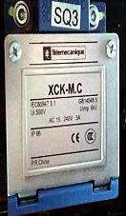
Guard Door Safety Switches
XX160-A5
JM168-MK6
non-safe switch
not compliant to safety regulations
Safety Switch Full Compliant to
Safety Standards

Slide 47
Power Pack
Comparisons of Specs
INTERNAL ONLY

Slide 48
Maxiumum Sustainable Power Output
slow, low power (15kW)
Fast, High Power (22kW)
XX160-A5
JM168-MK6
Pump: 50cc
Max. power: 17.5kW
Pump: 64cc
Max. power: 22kW

Slide 49
Impact of Maximum Power Output on Application Processes
Different applications require different power outputs (e.g. engineering resins and thin-walled parts require more power)
If process power demand exceeds servosystem limit, alarm is tripped and machine stops
Energy efficiency drops significantly when power output is close to limit
Notes: As a servo-pump system can achieve 0 rpm, ACTUAL energy consumption is NOT related to max. power limit
Power Demand by Process | 5kW | 10kW | 15kW | 20kW
JM168-MK6
XX160-A5 |  |  |  | trips alarm!

